Slide 1

Management
Fourteenth Edition
Chapter 2
Making Decisions
Copyright © 2018, 2016, 2014 Pearson Education, Inc. All Rights Reserved

Slide 2
Learning Objectives
2.1 Describe the eight steps in the decision-making process.
Develop your skill at being creative.
2.2 Explain the four ways managers make decisions.
2.3 Classify decisions and decision-making conditions.
2.4 Describe how biases affect decision making.
Know how to recognize when you’re using decision-making errors and biases and what to do about it
2.5 Identify effective decision-making techniques.

Slide 3
Be A Better Decision-Maker
A key to success in management and in your career is knowing how to be an effective decision-maker.

Slide 4

What is a Decision?
Decision—a choice among two or more alternatives
Notes:
Managers at all levels and in all areas of organizations make decisions. That is, they make choices. Although decision-making is typically described as choosing among alternatives, this view is too simplistic. Why? Because decision-making is (and should be) a process, not just a simple act of choosing among alternatives.
Source: Alex Segre/Alamy

Slide 5
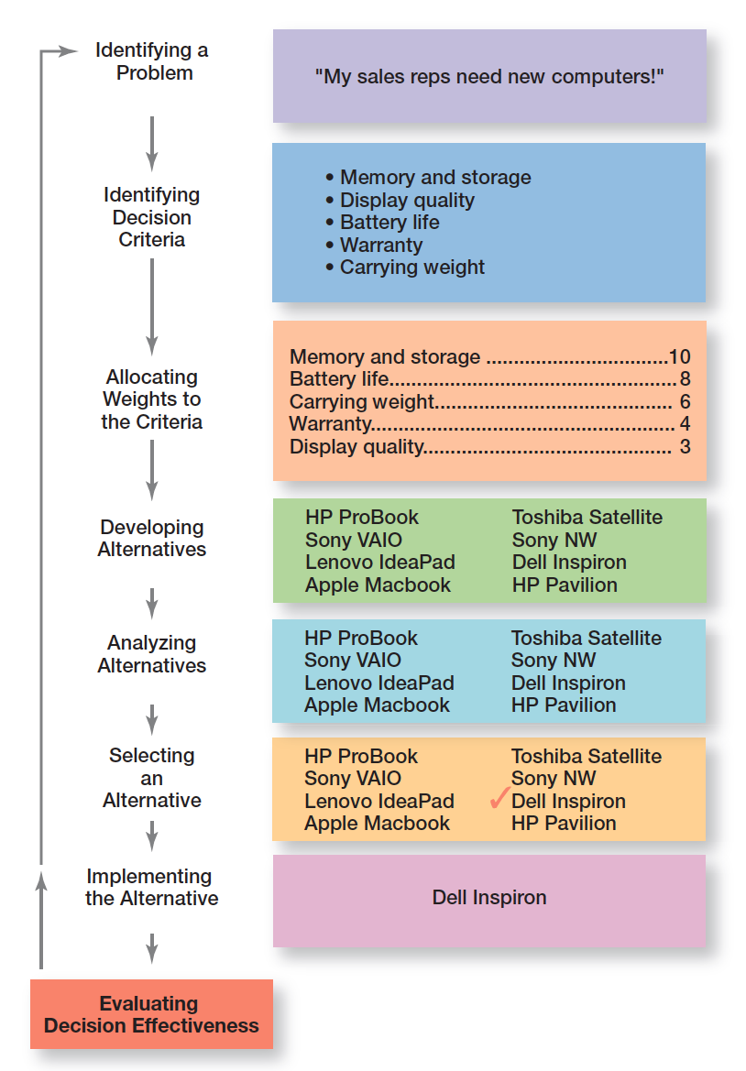
Exhibit 2-1 Decision-Making Process
Exhibit 2-1 shows the eight steps in the decision-making process. This process is as relevant to personal decisions as it is to corporate decisions.

Slide 6
Decision-Making Process Step 1: Identify a Problem
Problem: an obstacle that makes it difficult to achieve a desired goal or purpose.
Every decision starts with a problem, a discrepancy between an existing and a desired condition.
Example: Amanda is a sales manager whose reps need new laptops.
Notes:
Every decision starts with a problem, a discrepancy between an existing and a desired condition. For our example, Amanda is a sales manager whose reps need new laptops because their old ones are outdated and inadequate for doing their job. To make it simple, assume it’s not economical to add memory to the old computers and it’s the company’s policy to purchase, not lease. Now we have a problem—a disparity between the sales reps’ current computers (existing condition) and their need to have more efficient ones (desired condition). Amanda has a decision to make.

Slide 7
Decision-Making Process Step 2: Identify the Decision Criteria
Decision criteria are factors that are important to resolving the problem.
Example: Amanda decides that memory and storage capabilities, display quality, battery life, warranty, and carrying weight are the relevant criteria in her decision
Notes:
Once a manager has identified a problem, he or she must identify the decision criteria important or relevant to resolving
the problem. Every decision-maker has criteria guiding his or her decisions even if they’re not explicitly stated. In our example,
Amanda decides after careful consideration that memory and storage capabilities, display quality, battery life, warranty, and carrying weight are the relevant criteria in her decision.

Slide 8
Decision-Making Process Step 3: Allocate Weights to the Criteria
If the relevant criteria aren’t equally important, the decision maker must weight the items in order to give them the correct priority in the decision.
Example: The weighted criteria for Amanda’s computer purchase are shown in Exhibit 2-2.
Notes:
If the relevant criteria aren’t equally important, the decision maker must weight the items in order to give them the correct
priority in the decision. How? A simple way is to give the most important criterion a weight of 10 and then assign weights to the rest using that standard. Of course, you could use any number as the highest weight. The weighted criteria for our example is shown in Exhibit 2-2.

Slide 9
Exhibit 2-2 Important Decision Criteria
Criterion | Weight
Memory and storage | 10
Battery life | 8
Carrying weight | 6
Warranty | 4
Display quality | 3

Slide 10
Decision-Making Process Step 4: Develop Alternatives
List viable alternatives that could solve the problem.
Example: Amanda identifies eight laptops as possible choices (shown in Exhibit 2-3).
Notes:
The fourth step in the decision-making process requires the decision maker to list viable alternatives that could resolve the problem. In this step, a decision maker needs to be creative, and the alternatives are only listed—not evaluated—just yet. Our sales manager, Amanda, identifies eight laptops as possible choices (see Exhibit 2-3).

Slide 11
Exhibit 2-3 Possible Alternatives
Laptop | Memory and Storage | Battery Life | Carrying Weight | Warranty | Display Quality
HP ProBook | 10 | 3 | 10 | 8 | 5
Lenovo IdeaPad | 8 | 5 | 7 | 10 | 10
Apple MacBook | 8 | 7 | 7 | 8 | 7
Toshiba Satellite | 7 | 8 | 7 | 8 | 7
Apple MacBook Air | 8 | 3 | 6 | 10 | 8
Dell Inspirion | 10 | 7 | 8 | 6 | 7
HP Pavilion | 4 | 10 | 4 | 8 | 10

Slide 12
Decision-Making Process Step 6: Select an Alternative
Choose the alternative that generates the highest total in Step 5.
Notes:
The sixth step in the decision-making process is choosing the best alternative or the one that generated the highest total in Step 5. In our example (Exhibit 2-4), Amanda would choose the Dell Inspiron because it scored higher than all other alternatives (249 total).

Slide 13
Exhibit 2-4 Evaluation of Alternatives
Laptop | Memory and Storage | Battery Life | Carrying Weight | Warranty | Display Quality | Total
HP ProBook | 100 | 24 | 60 | 32 | 15 | 231
Lenovo IdeaPad | 80 | 40 | 42 | 40 | 30 | 232
Apple MacBook | 80 | 56 | 42 | 32 | 21 | 231
Toshiba Satellite | 70 | 64 | 42 | 32 | 21 | 229
Apple MacBook Air | 80 | 24 | 36 | 40 | 24 | 204
Dell Inspirion | 100 | 56 | 48 | 24 | 21 | 249
HP Pavilion | 40 | 80 | 24 | 32 | 30 | 206

Slide 14
Decision-Making Process Step 7: Implement the Alternative
Put the chosen alternative into action.
Convey the decision to those affected and get their commitment to it.
Notes:
In Step 7 in the decision-making process, you put the decision into action by conveying it to those affected and getting their commitment to it. We know that if the people who must implement a decision participate in the process, they’re more likely to support it than if you just tell them what to do. Another thing managers may need to do during implementation is reassess the environment for any changes, especially if it’s a long-term decision. Are the criteria, alternatives, and choice still the best ones, or has the environment changed in such a way that we need to reevaluate?

Slide 15
Decision-Making Process Step 8: Evaluate Decision Effectiveness
Evaluate the result or outcome of the decision to see if the problem was resolved.
If it wasn’t resolved, what went wrong?
Notes:
The last step in the decision-making process involves evaluating the outcome or result of the decision to see whether the problem was resolved. If the evaluation shows that the problem still exists, then the manager needs to assess what went wrong. Was the problem incorrectly defined? Were errors made when evaluating alternatives? Was the right alternative selected but poorly implemented? The answers might lead you to redo an earlier step or might even require starting the whole process over.

Slide 16
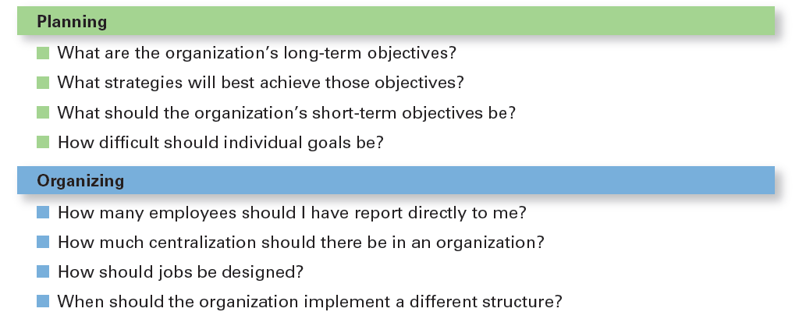
Exhibit 2-5 Decisions Managers May Make: Planning and Organizing
Notes:
Although everyone in an organization makes decisions, decision-making is particularly important to managers. As Exhibit 2-5 shows, it’s part of all four managerial functions. In fact, that’s why we say that decision-making is the essence of management. And that’s why managers—when they plan, organize, lead, and control—are called decision makers.

Slide 17
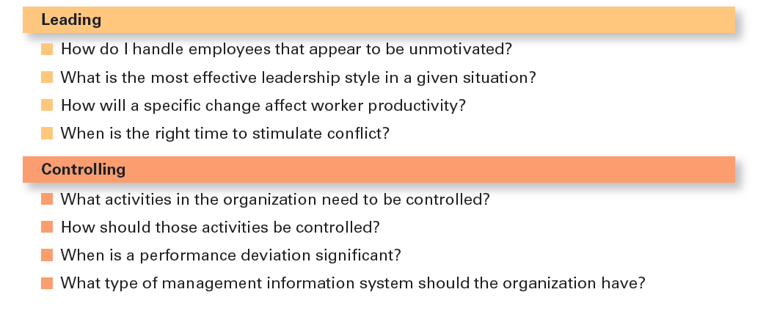
Exhibit 2-5 Decisions Managers May Make: Leading and Controlling

Slide 18
Rationality
Rational Decision-Making: choices that are logical and consistent and maximize value
Assumptions of rationality:
Rational decision maker is logical and objective
Problem faced is clear and unambiguous
Decision maker would have clear, specific goal and be aware of all alternatives and consequences
The alternative that maximizes achieving this goal will be selected
Decisions are made in the best interest of the organization
Notes:
We assume that managers will use rational decision-making; that is, they’ll make logical and consistent choices to maximize value. After all, managers have all sorts of tools and techniques to help them be rational decision makers. Managers aren’t always rational. What does it mean to be a “rational” decision maker? A rational decision maker would be fully objective and logical. The problem faced would be clear and unambiguous, and the decision maker would have a clear and specific goal and know all possible alternatives and consequences. Finally, making decisions rationally would consistently lead to selecting the alternative that maximizes the likelihood of achieving that goal.
These assumptions apply to any decision—personal or managerial. However, for managerial decision making, we need to add one additional assumption—decisions are made in the best interests of the organization. These assumptions of rationality aren’t very realistic and managers don’t always act rationally, but the next concept can help explain how most decisions get made in organizations.

Slide 19
Bounded Rationality
Bounded rationality: decision making that’s rational, but limited by an individual’s ability to process information
Satisfice: accepting solutions that are “good enough”
Escalation of commitment: an increased commitment to a previous decision despite evidence it may have been wrong
Notes:
A more realistic approach to describing how managers make decisions is the concept of bounded rationality, which says that managers make decisions rationally, but are limited (bounded) by their ability to process information. Because they can’t possibly analyze all information on all alternatives, managers satisfice, rather than maximize. That is, they accept solutions that are “good enough.” They’re being rational within the limits (bounds) of their ability to process information.
However, keep in mind that their decision-making is also likely influenced by the organization’s culture, internal politics, power considerations, and by a phenomenon called escalation of commitment, an increased commitment to a previous decision despite evidence that it may have been wrong.

Slide 20
Intuition
Intuitive decision-making: making decisions on the basis of experience, feelings, and accumulated judgment
Notes:
What is intuitive decision-making? It’s making decisions on the basis of experience, feelings, and accumulated judgment. Researchers studying managers’ use of intuitive decision-making have identified five different aspects of intuition, which are described in Exhibit 2-6.

Slide 21
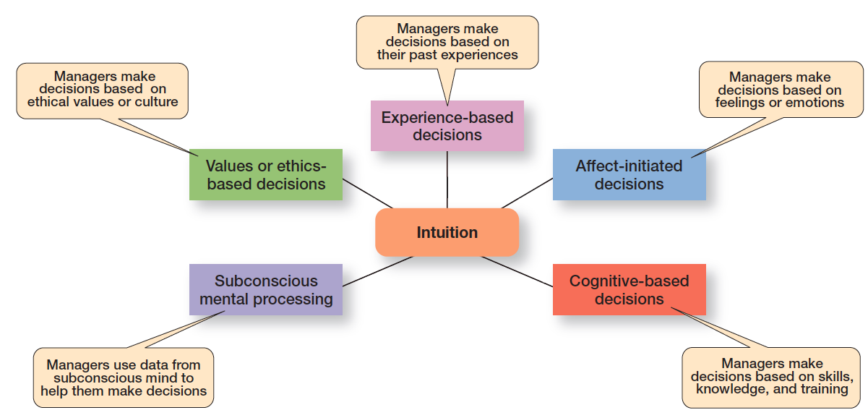
Exhibit 2-6 What is Intuition?
Exhibit 2-6 shows the five different aspects of intuition identified by researchers studying managers’ use of intuitive decision-making.
Notes:
Researchers studying managers’ use of intuitive decision making have identified five different aspects of intuition.
Source: Based on L. A. Burke and M. K. Miller, “Taking the Mystery Out of Intuitive Decision Making,” Academy of Management Executive, October 1999, pp. 91–99.

Slide 22
Evidence-Based Management
Evidence-based management (EBMgt): the systematic use of the best available evidence to improve management practice.
Notes:
“Any decision-making process is likely to be enhanced through the use of relevant and reliable evidence, whether it’s buying someone a birthday present or wondering which new washing machine to buy.” That’s the premise behind evidence-based management (EBMgt), the “systematic use of the best available evidence to improve management practice.
EBMgt is quite relevant to managerial decision-making. The four essential elements of EBMgt are the decision maker’s expertise and judgment; external evidence that’s been evaluated by the decision maker; opinions, preferences, and values of those who have a stake in the decision; and relevant organizational (internal) factors such as context, circumstances, and organizational members.

Slide 23
Types of Decisions: Structured Problems and Programmed Decisions
Structured problems: straightforward, familiar, and easily defined problems
Programmed decisions: repetitive decisions that can be handled by a routine approach
Notes:
Some problems are straightforward. The decision maker’s goal is clear, the problem is familiar, and information about the problem is easily defined and complete. Such situations are called structured problems because they’re straightforward, familiar, and easily defined. Because it’s not an unusual occurrence, there’s probably some standardized routine for handling it. This is what we call a programmed decision, a
repetitive decision that can be handled by a routine approach. Because the problem is structured, the manager doesn’t have to go to the trouble and expense of going through an involved decision process. The “develop-the-alternatives” stage of the decision-making process either doesn’t exist or is given little attention. Why? Because once the structured problem is defined, the solution is usually self-evident or at least reduced to a few alternatives that are familiar and have proved successful in the past.

Slide 24
Types of Programmed Decisions
Procedure: a series of sequential steps used to respond to a well-structured problem
Rule : an explicit statement that tells managers what can or cannot be done
Policy: a guideline for making decisions
Notes:
A procedure is a series of sequential steps a manager uses to respond to a structured problem. The only difficulty is identifying the problem. Once it’s clear, so is the procedure. For instance, a purchasing manager receives a request from a warehouse manager for 15 tablets for the inventory clerks.
A rule is an explicit statement that tells a manager what can or cannot be done. Rules are frequently used because they’re simple to follow and ensure consistency. For example, rules about lateness and absenteeism permit supervisors to make disciplinary decisions rapidly and fairly.
The third type of programmed decisions is a policy, a guideline for making a decision. In contrast to a rule, a policy establishes general parameters for the decision maker rather than specifically stating what should or should not be done. Policies typically contain an ambiguous term that leaves interpretation up to the decision maker.

Slide 25
Types of Decisions: Unstructured Problems and Nonprogrammed Decisions
Unstructured problems: problems that are new or unusual and for which information is ambiguous or incomplete
Nonprogrammed decisions: unique and nonrecurring and involve custom made solutions
Notes:
Not all the problems managers face can be solved using programmed decisions. Many organizational situations involve unstructured problems, new or unusual problems for which information is ambiguous or incomplete. Whether to build a new manufacturing facility in China is an example of an unstructured problem.

Slide 26
Exhibit 2-7 Programmed vs Nonprogrammed Decisions
Characteristic | Programmed Decisions | Nonprogrammed Decisions
Type of problem | Structured | Unstructured
Managerial level | Lower levels | Upper levels
Frequency | Repetitive, routine | New, unusual
Information | Readily available | Ambiguous or incomplete
Goals | Clear, specific | Vague
Time frame for solution | Short | Relatively long
Solution relies on… | Procedures, rules, policies | Judgment and creativity
Notes:
Exhibit 2-7 describes the differences between programmed and nonprogrammed decisions. Lower-level managers mostly rely on programmed decisions (procedures, rules, and policies) because they confront familiar and repetitive problems. As managers move up the organizational hierarchy, the problems they confront become more unstructured.

Slide 27
Decision-Making Conditions
Certainty: a situation in which a manager can make accurate decisions because all outcomes are known
Risk: a situation in which the decision maker is able to estimate the likelihood of certain outcomes
Uncertainty: a situation in which a decision maker has neither certainty nor reasonable probability estimates available
Notes:
The ideal situation for making decisions is one of certainty, a situation where a manager can make accurate decisions because the outcome of every alternative is known. For example, when Wyoming’s state treasurer decides where to deposit excess state funds, he knows exactly the interest rate offered by each bank and the amount that will be earned on the funds. He is certain about the outcomes of each alternative. As you might expect, most managerial decisions aren’t like this.
A far more common situation is one of risk, conditions in which the decision maker is able to estimate the likelihood of certain outcomes. Under risk, managers have historical data from past personal experiences or secondary information that lets them assign probabilities to different alternatives.
What happens if you face a decision where you’re not certain about the outcomes and can’t even make reasonable probability estimates? We call this condition uncertainty. Managers face decision-making situations of uncertainty. Under these conditions, the choice of alternative is influenced by the limited amount of available information and by the psychological orientation of the decision maker.

Slide 28
Managing Risk
Managers can use historical data or secondary information to assign probabilities to different alternatives
This is used to calculate expected value—the expected return from each possible outcome—by multiplying expected revenue by the probability of each alternative
Notes:
Under risk, managers have historical data from past personal experiences or secondary information that lets them assign probabilities to different alternatives.

Slide 29
Exhibit 2-8 Expected Value
Event | Expected Revenues | Probability | Expected Value of Each Alternative
Heavy snowfall | $850,000 | 0.3 | $255,000
Normal snowfall | $725,000 | 0.5 | $362,000
Light snowfall | $350,000 | 0.2 | $70,000
Blank | Blank | Total expected revenue: | $687,500
For each Event in the table, Expected Revenues multiplied by Probability gives the Expected Value of Each Alternative.
Notes:
Let’s try an example. Suppose you manage a Colorado ski resort, and you’re thinking about adding another lift. Obviously, your decision will be influenced by the additional revenue that the new lift would generate, which depends on snowfall. You have fairly reliable weather data from the last 10 years on snowfall levels in your area—three years of heavy snowfall, five years of normal snowfall, and two years of light snow. And you have good information on the amount of revenues generated during each level of snow.
You can use this information to help you make your decision by calculating expected value—the expected return from each possible outcome—by multiplying expected revenues by snowfall probabilities. The result is the average revenue you can expect over time if the given probabilities hold. As Exhibit 2-8 shows, the expected revenue from adding a new ski lift is $687,500. Of course, whether that’s enough to justify a decision to build depends on the costs involved in generating that revenue.

Slide 30
Exhibit 2-9 Payoff Matrix
Visa Marketing Strategy (in millions of dollars | MasterCard CA 1 | MasterCard CA 2 | MasterCard CA 3
Strategy 1 | 13 | 14 | 11
Strategy 2 | 9 | 15 | 18
Strategy 3 | 24 | 21 | 15
Strategy 4 | 18 | 14 | 28
Exhibit 2-9 shows the various Visa strategies and the resulting profit, depending on the competitive action (CA) used by MasterCard.
Notes:
A marketing manager at Visa has determined four possible strategies (Strategy 1, Strategy 2, Strategy 3, and Strategy 4) for promoting the Visa card throughout the West Coast region of the United States. The marketing manager also knows that major competitor MasterCard has three competitive actions (CA 1, CA 2, and CA 3) it’s using to promote its card in the same region. For this example, we’ll assume that the Visa manager had no previous knowledge that would allow her to determine probabilities of success of any of the four strategies. She formulates the matrix shown in Exhibit 2-9 to show the various Visa strategies and the resulting profit, depending on the competitive action used by MasterCard.

Slide 31
Exhibit 2-10 Regret Matrix
Visa Marketing Strategy (in millions of dollars | MasterCard CA 1 | MasterCard CA 2 | MasterCard CA 3
Strategy 1 | 11 | 7 | 17
Strategy 2 | 15 | 6 | 10
Strategy 3 | 0 | 0 | 13
Strategy 4 | 6 | 7 | 0
Exhibit 2-10 shows the regret for each category, which is found by subtracting all possible payoffs in each category from the maximum possible payoff for each given event, in this case for each competitive action.
Notes:
Managers calculate regret by subtracting all possible payoffs in each category from the maximum possible payoff for each given event, in this case for each competitive action. For our Visa manager, the highest payoff—given that MasterCard engages in CA1, CA2, or CA3—is $24 million, $21 million, or $28 million, respectively (the highest number in each column). Subtracting the payoffs in Exhibit 2-9 from those figures produces the results shown in Exhibit 2-10.

Slide 32
Heuristics
Heuristics or “rules of thumb” can help make sense of complex, uncertain, or ambiguous information.
However, they can also lead to errors and biases in processing and evaluating information.
Notes:
When managers make decisions, they not only use their own particular style, they may use “rules of thumb,” or heuristics, to simplify their decision-making. Rules of thumb can be useful because they help make sense of complex, uncertain, and ambiguous information. Even though managers may use rules of thumb, that doesn’t mean those rules are reliable. Why? Because they may lead to errors and biases in processing and evaluating information.

Slide 33
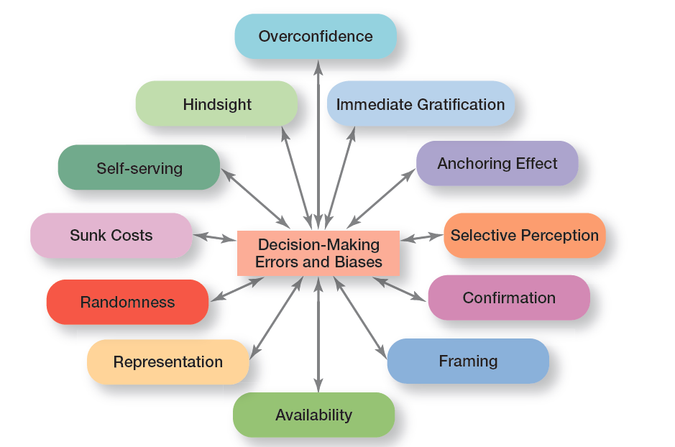
Exhibit 2-11 Common Decision-Making Biases
Exhibit 2-11 identifies 12 common decision errors of managers and biases they may have.
Notes:
Exhibit 2-11 identifies 12 common decision errors of managers and biases they may have. Let’s look at each.

Slide 34
Decision-Making Biases and Errors (1 of 4)
Overconfidence Bias: holding unrealistically positive views of oneself and one’s performance
Immediate Gratification Bias: choosing alternatives that offer immediate rewards and avoid immediate costs
Anchoring Effect: fixating on initial information and ignoring subsequent information
Notes:
When decision makers tend to think they know more than they do or hold unrealistically positive views of themselves and their performance, they’re exhibiting the overconfidence bias.
The immediate gratification bias describes decision makers who tend to want immediate rewards and to avoid immediate costs. For these individuals, decision choices that provide quick payoffs are more appealing than those with payoffs in the future.
The anchoring effect describes how decision makers fixate on initial information as a starting point and then, once set, fail to adequately adjust for subsequent information. First impressions, ideas, prices, and estimates carry unwarranted weight relative to information received later.

Slide 35
Decision-Making Biases and Errors (2 of 4)
Selective Perception Bias: selecting, organizing and interpreting events based on the decision maker’s biased perceptions
Confirmation Bias: seeking out information that reaffirms past choices while discounting contradictory information
Framing Bias: selecting and highlighting certain aspects of a situation while ignoring other aspects
Notes:
When decision makers selectively organize and interpret events based on their biased perceptions, they’re using the selective perception bias. This influences the information they pay attention to, the problems they identify, and the alternatives they develop.
Decision makers who seek out information that reaffirms their past choices and discount information that contradicts past judgments exhibit the confirmation bias.
The framing bias is when decision makers select and highlight certain aspects of a situation while excluding others. By drawing attention to specific aspects of a situation and highlighting them, while at the same time downplaying or omitting other aspects, they distort what they see and create incorrect reference points.

Slide 36
Decision-Making Biases and Errors (3 of 4)
Availability Bias: losing decision-making objectivity by focusing on the most recent events
Representation Bias: drawing analogies and seeing identical situations when none exist
Randomness Bias: creating unfounded meaning out of random events
Notes:
The availability bias happens when decisions makers tend to remember events that are the most recent and vivid in their memory. The result? It distorts their ability to recall events in an objective manner and results in distorted judgments and probability estimates.
When decision makers assess the likelihood of an event based on how closely it resembles other events or sets of events, that’s the representation bias. Managers exhibiting this bias draw analogies and see identical situations where they don’t exist.
The randomness bias describes the actions of decision makers who try to create meaning out of random events. They do this because most decision makers have difficulty dealing with chance even though random events happen to everyone, and there’s nothing that can be done to predict them.

Slide 37
Decision-Making Biases and Errors (4 of 4)
Sunk Costs Errors: forgetting that current actions cannot influence past events and relate only to future consequences
Self-serving Bias: taking quick credit for successes and blaming outside factors for failures
Hindsight Bias: mistakenly believing that an event could have been predicted once the actual outcome is known (after-the-fact)
Notes:
The sunk costs error occurs when decision makers forget that current choices can’t correct the past. They incorrectly fixate on past expenditures of time, money, or effort in assessing choices rather than on future consequences. Instead of ignoring sunk costs, they can’t forget them.
Decision makers who are quick to take credit for their successes and to blame failure on outside factors are exhibiting the self-serving bias.
Finally, the hindsight bias is the tendency for decision makers to falsely believe that they would have accurately predicted the outcome of an event once that outcome is actually known.

Slide 38
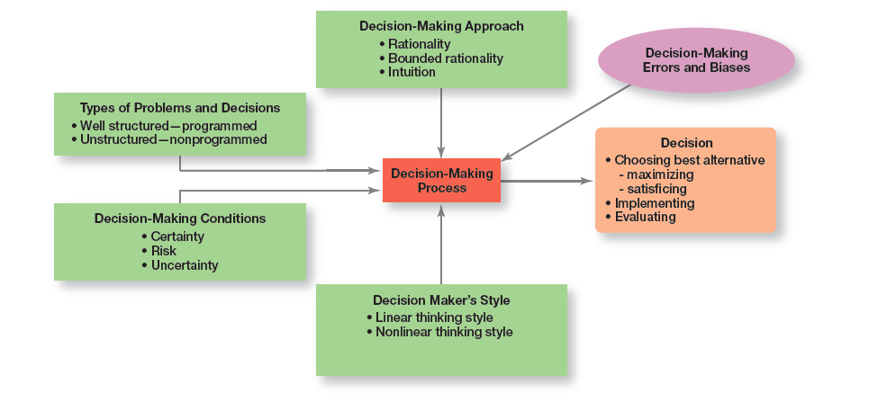
Exhibit 2-12 Overview of Managerial Decision Making
Exhibit 2-12 provides an overview of managerial decision making.
Notes:
Exhibit 2-12 provides an overview of managerial decision-making. Because it’s in their best interests, managers want to make good decisions—that is, choose the “best” alternative, implement it, and determine whether it takes care of the problem, which is the reason the decision was needed in the first place.
Their decision-making process is affected by four factors: the decision-making approach, the type of problem, decision-making conditions, and certain decision-making errors and biases. So whether a decision involves addressing an employee’s habitual tardiness, resolving a product quality problem, or determining whether to enter a new market, it has been shaped by a number of factors.

Slide 39
Guidelines for Making Effective Decisions
Understand cultural differences
Create standards for good decision making
Know when it’s time to call it quits
Use an effective decision-making process
Develop your ability to think clearly
Notes:
Decision-making is serious business. Your abilities and track record as an effective decision maker will determine how your organizational work performance is evaluated and whether you’ll be promoted to higher and higher positions of responsibility. Below are some guidelines to help you be a better decision maker.
Understand cultural differences. Managers everywhere want to make good decisions. However, is there only one “best” way worldwide to make decisions? Or does the “best way depend on the values, beliefs, attitudes, and behavioral patterns of the people involved?”
Create standards for good decision making. Good decisions are forward-looking, use available information, consider all available and viable options, and do not create conflicts of interest.
Know when it’s time to call it quits. When it’s evident that a decision isn’t working, don’t be afraid to pull the plug.
Use an effective decision-making process.
Build an organization that can spot the unexpected and quickly adapt to the changed environment.

Slide 40
Characteristics of an Effective Decision-Making Process
Focuses on what’s important
Is logical and consistent
Acknowledges subjective and analytical thinking, blends analytical with intuitive thinking
Requires only as much information as is needed to resolve particular dilemma
Encourages the gathering of relevant information
Is straightforward, reliable, easy-to-use, flexible
Notes:
Experts say an effective decision-making process has these six characteristics: (1) it focuses on what’s important; (2) it’s logical and consistent; (3) it acknowledges both subjective and objective thinking and blends analytical with intuitive thinking; (4) it requires only as much information and analysis as is necessary to resolve a particular dilemma; (5) it encourages and guides the gathering of relevant information and informed opinion; and (6) it’s straightforward, reliable, easy to use, and flexible.

Slide 41
Design Thinking and Decision Making
Design thinking: approaching management problems as designers approach design problems
Notes:
The way managers approach decision-making—using a rational and analytical mindset in identifying problems, coming up with alternatives, evaluating alternatives, and choosing one of those alternatives—may not be best and certainly not the only choice in today’s environment. That’s where design thinking comes in. Design thinking has been described as “approaching management problems as designers approach design problems.”
What can the design thinking approach teach managers about making better decisions? Well, it begins with the first step of identifying problems. Design thinking says that managers should look at problem identification collaboratively and integratively, with the goal of gaining a deep understanding of the situation. They should look not only at the rational aspects, but also at the emotional elements. Then invariably, of course, design thinking would influence how managers identify and evaluate alternatives. “A traditional manager (educated in a business school, of course) would take the options that have been presented and analyze them based on deductive reasoning and then select the one with the highest net present value. However, using design thinking, a manager would say, ‘What is something completely new that would be lovely if it existed but doesn’t now?’ ”
Design thinking means opening up your perspective and gaining insights by using observation and inquiry skills and not relying simply on rational analysis.

Slide 42
Big Data and Decision-Making
Big data: the vast amount of quantifiable data that can be analyzed by highly sophisticated data processing
Can be a powerful tool in decision making, but collecting and analyzing data for data’s sake is wasted effort
Notes:
So what is big data? It’s the vast amount of quantifiable information that can be analyzed by highly sophisticated data processing. One IT expert described big data with “3V’s: high volume, high velocity, and/or high variety information assets.”
What does big data have to do with decision making? A lot, as you can imagine. With this type of data at hand, decision makers have very powerful tools to help them make decisions. However, experts caution that collecting and analyzing data for data’s sake is wasted e ort. Goals are needed when collecting and using this type of information. As one individual said, “Big data is a descendant of Taylor’s ‘scientific management’ of more than a century ago.”
While Taylor used a stopwatch to time and monitor a worker’s every movement, big data is using math modeling, predictive algorithms, and artificial intelligence software to measure and monitor people and machines like never before. But managers need to really examine and evaluate how big data might contribute to their decision making before jumping in with both feet. Why? Because big data, no matter how comprehensive or well analyzed, needs to be tempered by good judgment. For instance, a recent government report states: “Companies should remember that while big data is very good at detecting correlations, it does not explain which correlations are meaningful.”

Slide 43
Review Learning Objective 2.1
Describe the eight steps in the decision-making process.
1. Identify problem
2. Identify decision criteria
3. Weight the criteria
4. Develop alternatives
5. Analyze alternatives
6. Select alternative
7. Implement alternative
8. Evaluate decision effectiveness
Notes:
A decision is a choice. The decision-making process consists of eight steps: (1) identify problem; (2) identify decision criteria; (3) weight the criteria; (4) develop alternatives; (5) analyze alternatives; (6) select alternative; (7) implement alternative; and (8) evaluate decision effectiveness.

Slide 44
Review Learning Objective 2.2 (1 of 2)
Explain the four ways managers make decisions.
Assumptions of rationality
The problem is clear and unambiguous
A single, well-defined goal is to be achieved
All alternatives and consequences are known
The final choice will maximize the payoff
Notes:
The assumptions of rationality are as follows: the problem is clear and unambiguous; a single, well-defined goal is to be achieved; all alternatives and consequences are known; and the final choice will maximize the payoff. Bounded rationality says that managers make rational decisions but are bounded (limited) by their ability to process information.

Slide 45
Review Learning Objective 2.2 (2 of 2)
Satisficing: when decision makers accept solutions that are good enough
Escalation of commitment: managers increase commitment to a decision, even when they have evidence it may have been a wrong decision
Intuitive decision making: making decisions on the basis of experience, feelings, and accumulated judgment
Evidence-based management: a manager makes decisions based on the best available evidence
Notes:
Satisficing happens when decision makers accept solutions that are good enough. With escalation of commitment, managers increase commitment to a decision, even when they have evidence it may have been a wrong decision. Intuitive decision making means making decisions on the basis of experience, feelings, and accumulated judgment. Using evidence-based management, a manager makes decisions based on the best available evidence.

Slide 46
Review Learning Objective 2.3 (1 of 2)
Classify decisions and decision-making conditions.
Programmed decisions are repetitive decisions that can be handled by a routine approach and are used when the problem being resolved is straightforward, familiar, and easily defined (structured).
Nonprogrammed decisions are unique decisions that require a custom-made solution and are used when the problems are new or unusual (unstructured) and for which information is ambiguous or incomplete.
Notes:
Programmed decisions are repetitive decisions that can be handled by a routine approach and are used when the problem being resolved is straightforward, familiar, and easily defined (structured). Nonprogrammed decisions are unique decisions that require a custom-made solution and are used when the problems are new or unusual (unstructured) and for which information is ambiguous or incomplete.

Slide 47
Review Learning Objective 2.3 (2 of 2)
Classify decisions and decision-making conditions.
Certainty is a situation in which a manager can make accurate decisions because all outcomes are known.
Risk is a situation in which a manager can estimate the likelihood of certain outcomes.
Uncertainty is a situation in which a manager is not certain about the outcomes and can’t even make reasonable probability estimates
Notes:
Certainty is a situation in which a manager can make accurate decisions because all outcomes are known. Risk is a situation in which a manager can estimate the likelihood of certain outcomes. Uncertainty is a situation in which a manager is not certain about the outcomes and can’t even make reasonable probability estimates. When decision makers face uncertainty, their psychological orientation will determine whether they follow a maximax choice (maximizing the maximum possible payoff); a maximin choice (maximizing the minimum possible payoff); or a minimax choice (minimizing the maximum regret—amount of money that could have been made if a different decision had been made).

Slide 48
Review Learning Objective 2.4
Describe how biases affect decision-making.
The 12 common decision-making errors and biases:
Overconfidence
Immediate gratification
Anchoring effect
Selective perception
Confirmation
Framing
Availability
Representation
Randomness
Sunk costs
Self-serving
Hindsight
Notes:
The 12 common decision-making errors and biases include overconfidence, immediate gratification, anchoring, selective perception, confirmation, framing, availability, representation, randomness, sunk costs, self-serving bias, and hindsight. The managerial decision making model helps explain how the decision-making process is used to choose the best alternative(s), either through maximizing or Satisficing and then implement and evaluate the alternative. It also helps explain what factors affect the decision-making process, including the decision-making approach (rationality, bounded rationality, intuition), the types of problems and decisions (well structured and programmed or unstructured and nonprogrammed), the decision-making conditions (certainty, risk, uncertainty), and the decision maker’s style (linear or nonlinear).

Slide 49
Review Learning Objective 2.5 (1 of 2)
Identify effective decision-making techniques.
An effective decision-making process:
Focuses on what’s important
Is logical and consistent
Acknowledges subjective and objective thinking and blends analytical and intuitive approaches
Requires only “enough” information as is needed to solve a problem
Encourages and guides gathering relevant information and informed opinions
Is straightforward, reliable, easy to use, and flexible
Notes:
Managers can make effective decisions by understanding cultural differences in decision-making, knowing when it’s time to call it quits, using an effective decision-making process, and building an organization that can spot the unexpected and quickly adapt to the changed environment. An effective decision-making process (1) focuses on what’s important; (2) is logical and consistent; (3) acknowledges both subjective and objective thinking and blends both analytical and intuitive approaches; (4) requires only “enough” information as is necessary to resolve a problem.

Slide 50
Review Learning Objective 2.5 (2 of 2)
Design thinking: approaching management problems as designers approach design problems
Big Data: when tempered with good judgment, it can be a powerful tool in decision making
Notes:
Managers can make effective decisions by understanding cultural differences in decision-making, knowing when it’s time to call it quits, using an effective decision-making process, and building an organization that can spot the unexpected and quickly adapt to the changed environment. An effective decision-making process (1) focuses on what’s important; (2) is logical and consistent; (3) acknowledges both subjective and objective thinking and blends both analytical and intuitive approaches; (4) requires only “enough” information as is necessary to resolve a problem.

Slide 51

Copyright

